Slide 1
CSE 551 Mid-point update presentation
By Group 11
Mandar Laxmikant Mahajan (SBU ID: 113276053)
Akanksha Kale (SBU ID: 113788594)
Akhila Juturu (SBU ID: 114777498)
Notes:
Hello everyone, I’m Akhila and I will be presenting for group 11 today.

Slide 2
An Open-source Extendable Model and Corrective Measure Assessment of the 2021 Texas Power Outage
by Wu et. al. in 2020
Notes:
According to the feedback received in our project proposal, we researched several papers and have chosen the paper “An Open-source Extendable Model and Corrective Measure Assessment of the 2021 Texas Power Outage“. This paper creates an open-source simulation model for the 2021 Texas Power outage. We plan to use various parameters for the simulation model to simulate and perform ‘what-if’ analysis in the scenario of this power outage. This would serve as a ground to evaluate different resilient recovery protocols. Our final goal of our project is trying to extend this paper.

Slide 3
GOAL #1
Case Study of 2021 Texas Power Outage

Slide 4
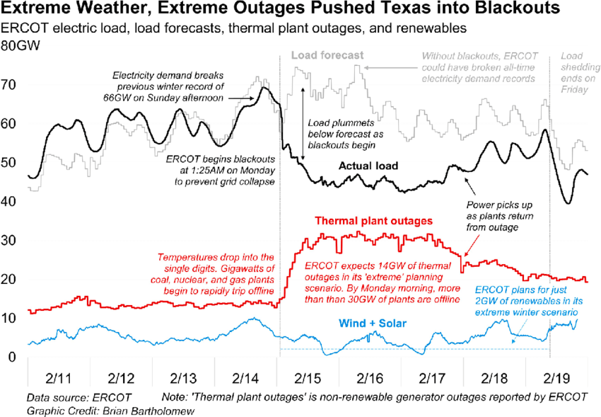
-Unprecedented winter storms that hit across Texas in February 2021
- 69 deaths and 4.5 million customer interruptions
-Blackout : February 14 to February 19.
Notes:
Blackout occurred during Feb 14 to Feb 15
Electricity demand on 14th has risen up due to cold weather and electricity generation sources began to collapse.
As Load shedding began, it led to hug difference in actual load and load forecast as shown in the figure.

Slide 5
Main factors that led to this situation:
The cold weather had Much higher electricity demand: Cold weather is driving electricity demand far higher than normal. As 60% of Texans heat themselves with electricity, winter power demand is very sensitive to temperature changes.
Lower natural gas production: Most of Texas’ electricity demand is met with natural gas. When demand rises, nearly all the incremental supply comes from gas-fired power generation. But the cold weather hampered gas production. As a result, there wasn’t enough to supply the system’s gas generators.
Generation equipment outages: The unavailability of natural gas resulted in gas generators declaring their resources unavailable. Some wind turbines were also frozen cutting their potential output although low wind was a more significant issue. Coal plants are operating 40% below rated capacity, and one of the four nuclear facilities in the state was shut down due to weather-related loss of feed water pumps.
Notes:
Main factors that led to this situation are
The cold weather had Much higher Electricity demand
Lower natural gas Production
Generation equipment outages

Slide 6
Power grid resilience enhancement strategies
(a) physical hardiness such as vegetation management , substation relocation, selective undergrounding and etc.,
b) operational capability such as emergency generator, distributed energy resources, grid monitoring system and etc
Notes:
The existing studies of power grid resilience to extreme weather conditions offer power grid resilience enhancement strategies mainly in two perspectives: a, b

Slide 7
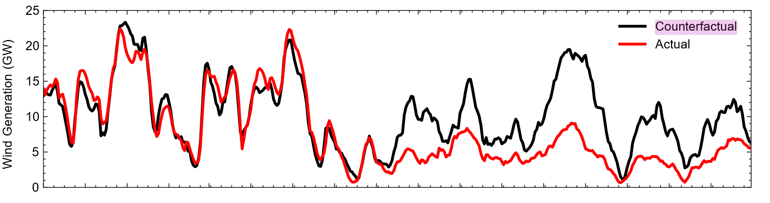
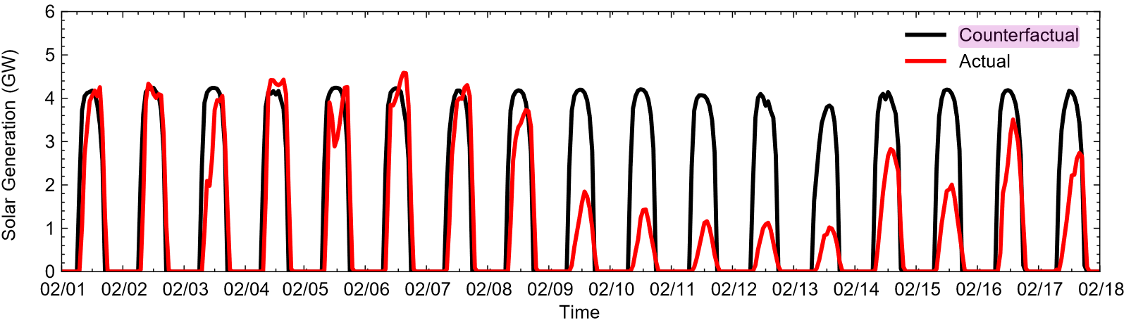
Counterfactual vs Actual energy generation
Notes:
Counterfactual energy generation refers to the 7-day-ahead load forecast. This is the energy that the system itself had predicted that it would be able to generate. Here, from these graphs, you can see that there were great matches between actual and counterfactual wind and solar generation profiles before February 9. It also indicates that the impacts of the winter storm on renewable generation approximately started as early as February 9. This gives a leading indicator of the impending grid failure that would occur in the following days.

Slide 8
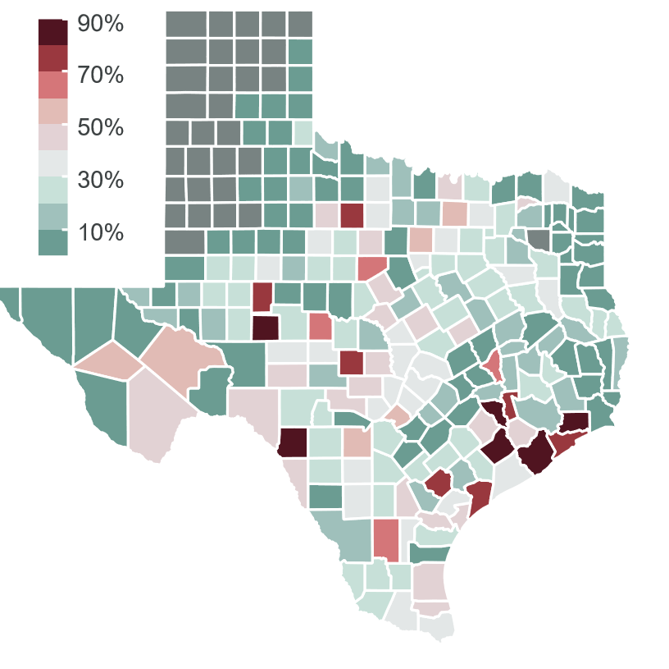
Impact of the grid failure
Satellite counties around Houston in the Coast zone and several counties distributed in the West zone suffered the most severe outages
Due to the continued power outages across the state, many were faced with freezing temperatures in their homes
Figure: county-wise customer outage percentages
Notes:
Here, you can see the county-level customer outage percentage in Texas. Mainly, satellite counties around Houston in the Coast zone and several counties distributed in the West zone suffered the most severe outages.
The reason that this power outage was deemed so dangerous is that due to winterization, many people faced freezing temperatures in their homes.

Slide 9
GOAL #2
Data Analysis

Slide 10
Dataset
What is the data about?
Grid information - from The Electric Reliability Council of Texas
Generation units outage data - from the U.S. Energy Information Administration
actual load by weather zone
actual generation by source
actual available generation capacity
actual load shedding
customer power outage
Notes:
The paper that we were referring to had a few dataset in its references. One source as the grid information from The Electric Reliability Council of Texas. One other source was Generation units outage data - from the U.S. Energy Information Administration.
The data gives information about the following:
actual load by weather zone
actual generation by source
actual available generation capacity
actual load shedding
customer power outage

Slide 11
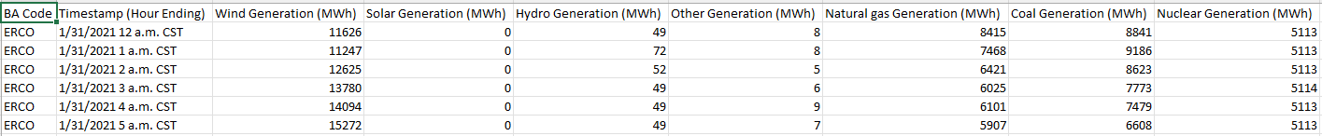
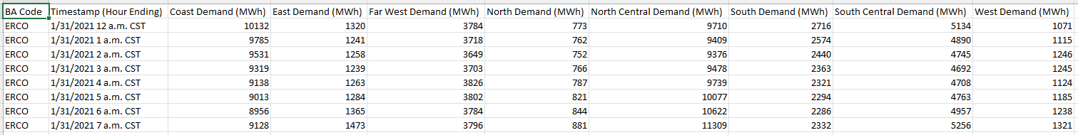
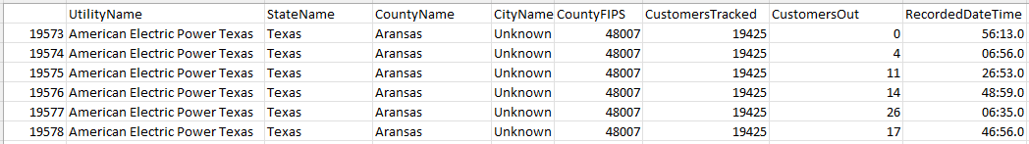
Table: Source generation data from ERCOT
Table: Demand by subregion from ERCOT
Table: Customer outage data
Notes:
So here are some small data snippets from the data, just to give an idea of the data. We won’t go into details about the columns in interest of time.
We have source generation data, which lists energy produced in Mega wattage hours for different sources such as solar, wind, etc.
Then we have snippets of energy demand from different regions. We also have customer outage data, which gives out of customers being tracked, how many faced outages and at what times were these outages reported.

Slide 12
GOAL #3
Simulation on Texas Power Grid Data

Slide 13
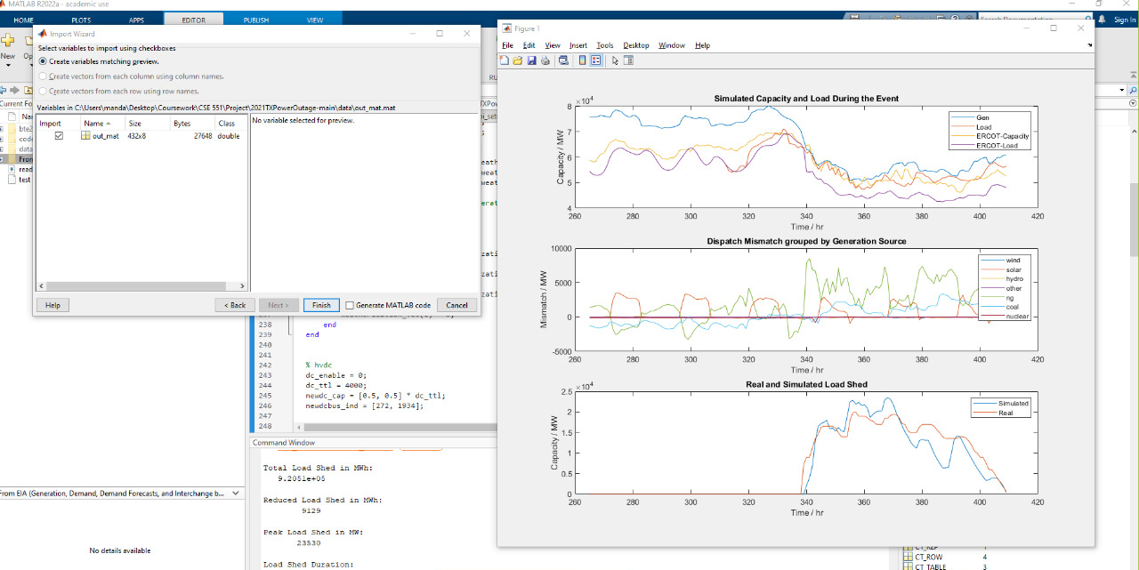
Preliminary simulation results
Notes:
We use a synthetic grid model that is calibrated based on open-source datasets mentioned in the previous slides to run a preliminary simulation of the grid failure without changing any parameters using MATLAB. We will change different parameters of the simulation and try to see if any strategy is able to improve the ability of the system to recover from the failure quicker.

Slide 14
We can analyze a real-world power grid during extreme events to have high fidelity characterization of what could have been corrected in large power grids.
The design of this open- source synthetic grid can be easily reconfigured, making it very convenient to conduct further analysis. Particularly to estimate and predict the impacts of interdependence between two energy infrastructure systems on the overall energy system reliability and stability.

Slide 15
Next Steps
Quantitative Assessment of Corrective Measures against Extreme Frigid Weather
• Generator Outage
• Generator Weatherization
• Energy Storage
Notes:
To shed more light on this
-Assess several corrective measures that could have mitigated the blackout under such extreme weather conditions.
-Uncover the regional disparity of load shedding.
-Quantifies the sensitivity of several corrective measures with respect to mitigating the severity of the power outage, as measured in Energy-not-Served (ENS)

Slide 16
Goals
Quantitative Analysis of Corrective measures
Find out disparity among the winterization effectiveness.
Notes:
Leveraging the synthetic grid, we perform quantitative analysis on the corrective measures in the aspect of reducing the extent of blackout events. We will find out disparity among the winterization effectiveness for generation units of various source types and geographical regions, and do a quantitative assessment of certain corrective portfolios, and the interdependence of per-unit performance of corrective measures.

